Slide 1
Diabetes Risk Forecast
By Hernan Trujillo

Slide 2
Scope
Target
Dataset
Visualization
Predictive Model to diagnose Diabetes
2,000 Females from 21 to 81 Years old
Data Science results and recommendations
Impact Hypothesis
EDA
Exploratory Data Analysis of the features and data in general
Develop new markets : Pre-diabetic patients
Develop new products or services: Preventive treatments offered to patients

Slide 3
Diabetes basics
What is diabetes?
How is it diagnosed?
What are the symptoms?
Diabetes is a disease in which your blood glucose, or blood sugar, levels are too high. Glucose comes from the foods you eat.
Through blood tests. The blood tests show if your blood glucose, also called blood sugar, is too high.
Fatigue
Tingling
No healing
Weight lose

Slide 4

Diabetes infographic
80%
Symptoms
At least 80% of patients with diabetes don’t know their condition.
50%
Weight loss
65%
Thirst
75%
Fatigue
Prevention and treatment
Diabetic Patients in USA
1 in 10
Diabetic
1 in 3
Pre-Diabetic
Healthy food
Exercise
Insulin

Slide 5
Diabetes Diagnostic
Positive
34%
TOTAL DIABETES
2,000 Female patients from 21 to 81 years old
Negative
66%

Slide 6
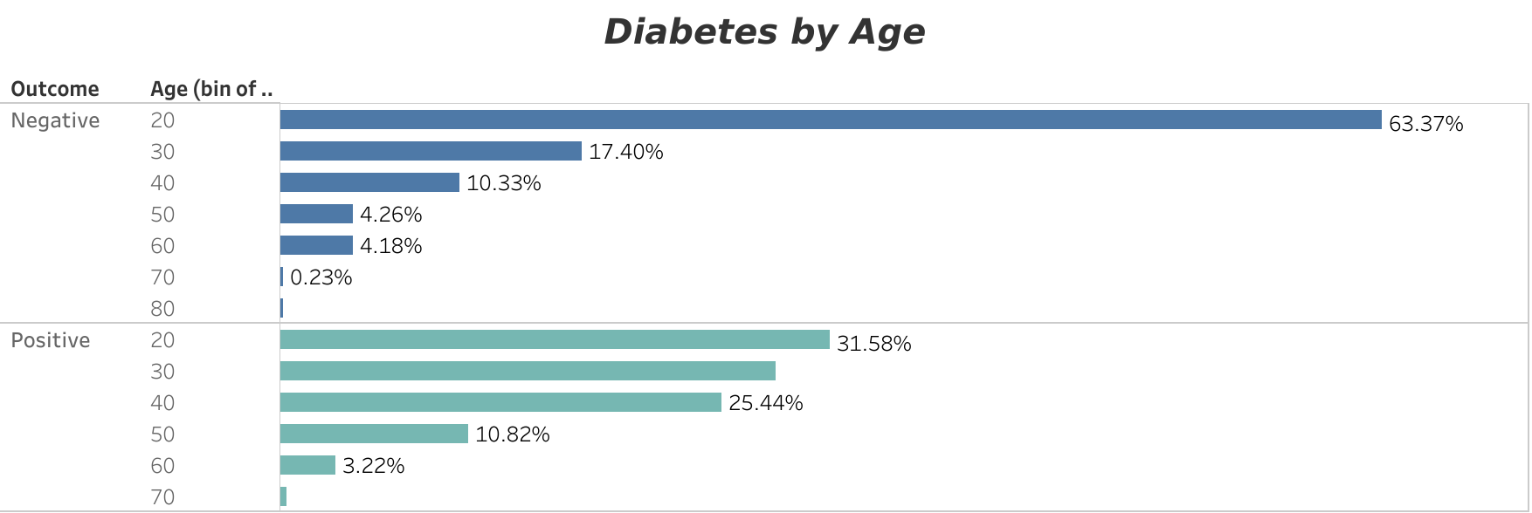
Among our group of patients that participated in our study, 90% of diabetic patients are grouped between 21 to 49 years old

Slide 7
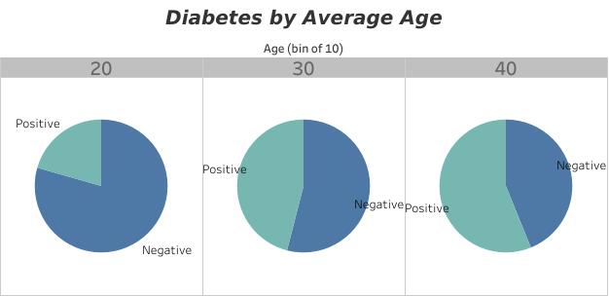
Also, we can notice the increment with ”Positive” diagnostic among those groups

Slide 8
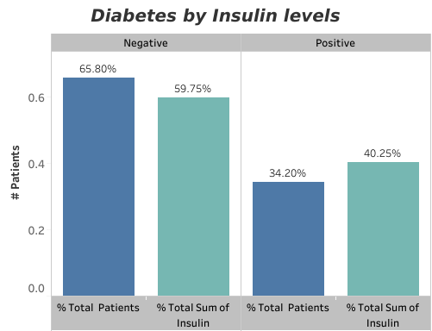
Diabetes and Insulin
Affects of Diabetes
Eye disease
Heart disease
Kidney disease
Nerve damage
Feet damage
According to a report by the American Diabetes Association (ADA) major brand insulin list prices have increased by 252%

Slide 9
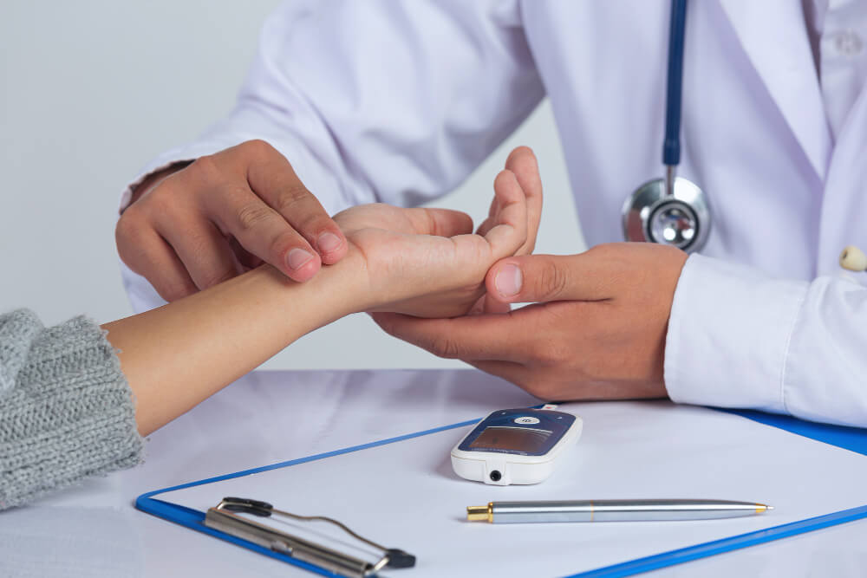
Diabetes Symptoms
SYMPTOMS
Slow healing
Sweating
Sugar control
Thirst

Slide 10
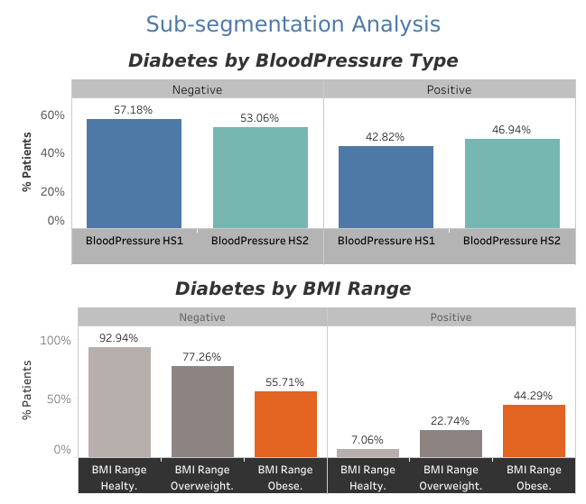
Monitoring
5.8
5%

Slide 11
Diabetes Prevention
14%
Healthy Diet
33%
A
Including Diabetes Risk Forecast as part of your regular check-ups is highly recommended.
25%
Hydration
Regular Check-ups
28%
Visual care
0
B
Avoid fast food and regular exercise
8 glasses of water daily
At twice once a Year
Once a year minimum

Slide 12
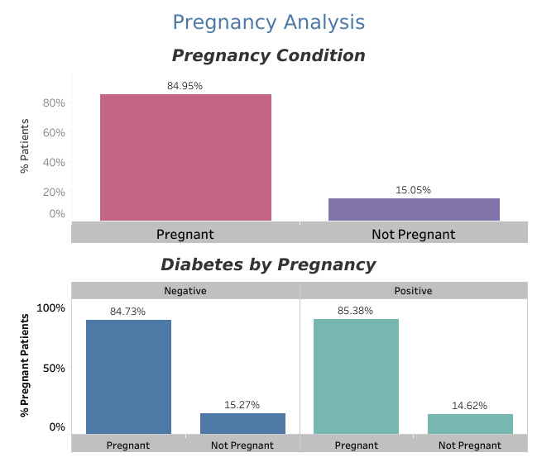
Pregnancy
Weight
Healthy
Exercise
Insuline
Medicine
Control

Slide 13
Data Science Solution
Classification Model
Decision Tree Classifier
CV score: 0.957500 Sdv:(0.043675)
Logistic Regression Classifier
CV score: 0.743500
Std : (0.056294)
K Neighbors Classifier
CV score: 0.640500
Std : (0.047101)

Slide 14
Recommendations
Symptoms
Treatment
Dizziness
Take medicine
Fatigue
Eat healthy
Weight loss
Monitor (Diabetes Risk Test)

Slide 15
Future Work
Expand the model
By adding additional features such as race and ethnicity
Adding Locations
For potential business by selling a successful classification model to other hospitals and government.
Evaluate other Classification Models
To test the accuracy of our selected model with others.

Slide 16
THANK YOU
AREAS AFFECED
Kidney
Heart
Sight
Brain
Feet
Ears

Slide 17
Appendix
8.5
Tableau
Python
Jupiter is the biggest planet of them all
Venus is the closest planet of the sun
Excel
Others
It’s the farthest planet from the sun
Public resources

Slide 18
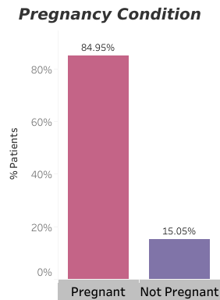
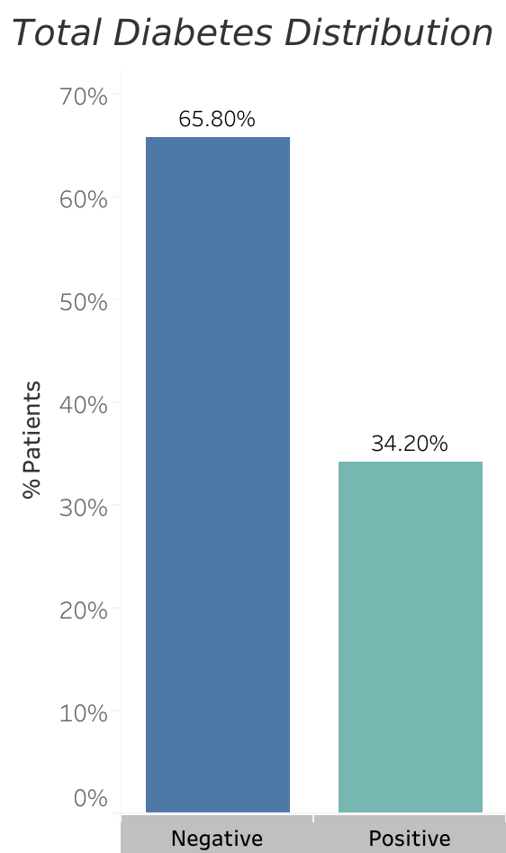
TABLEAU

Slide 19
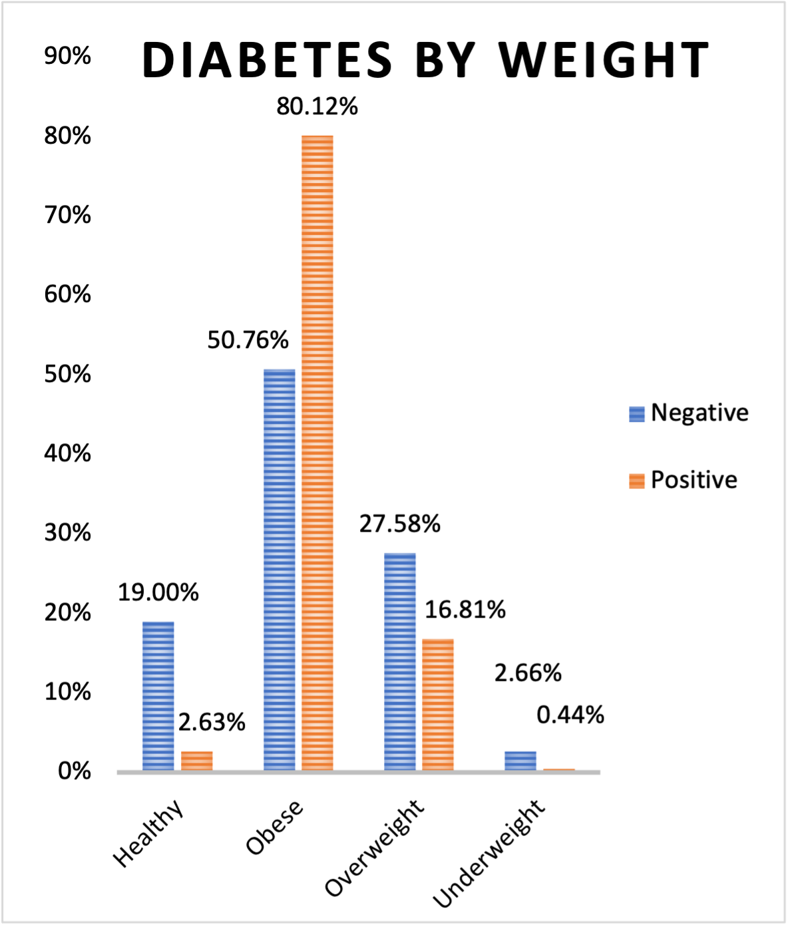
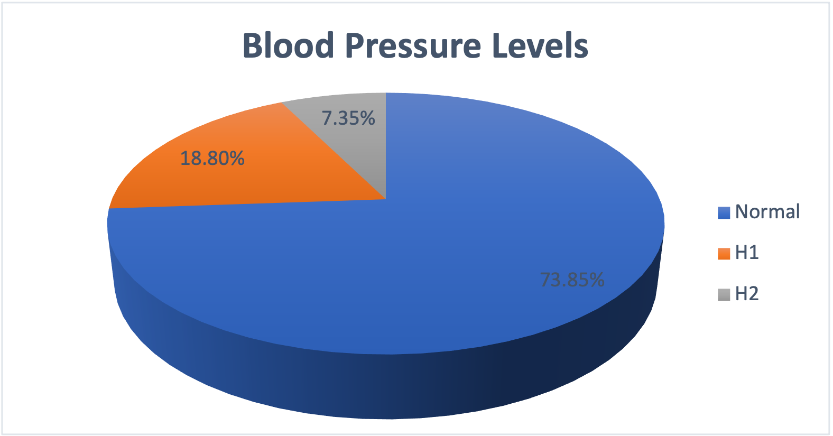
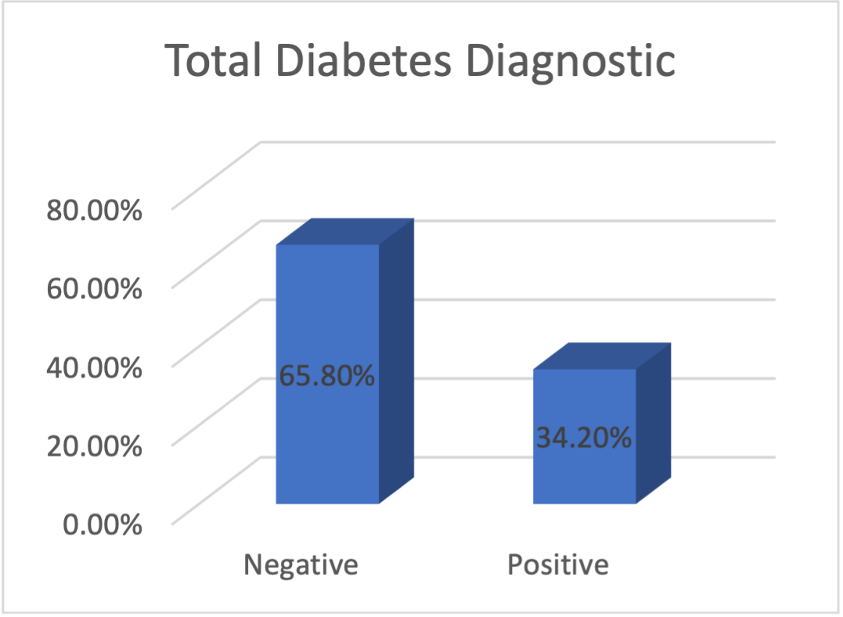
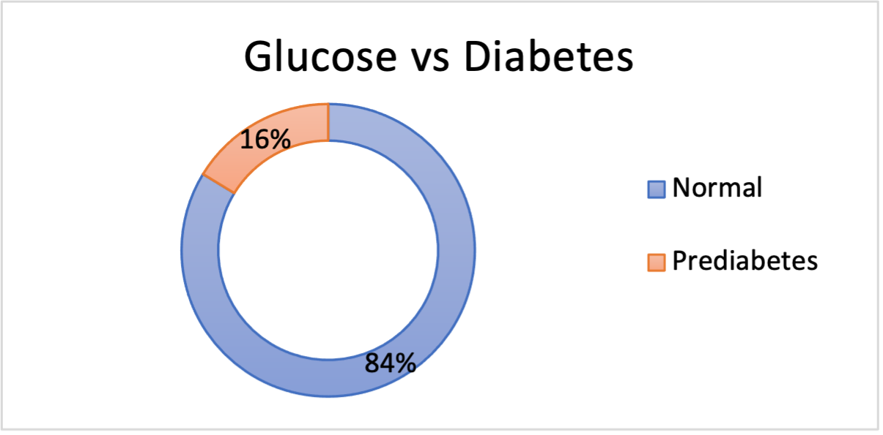
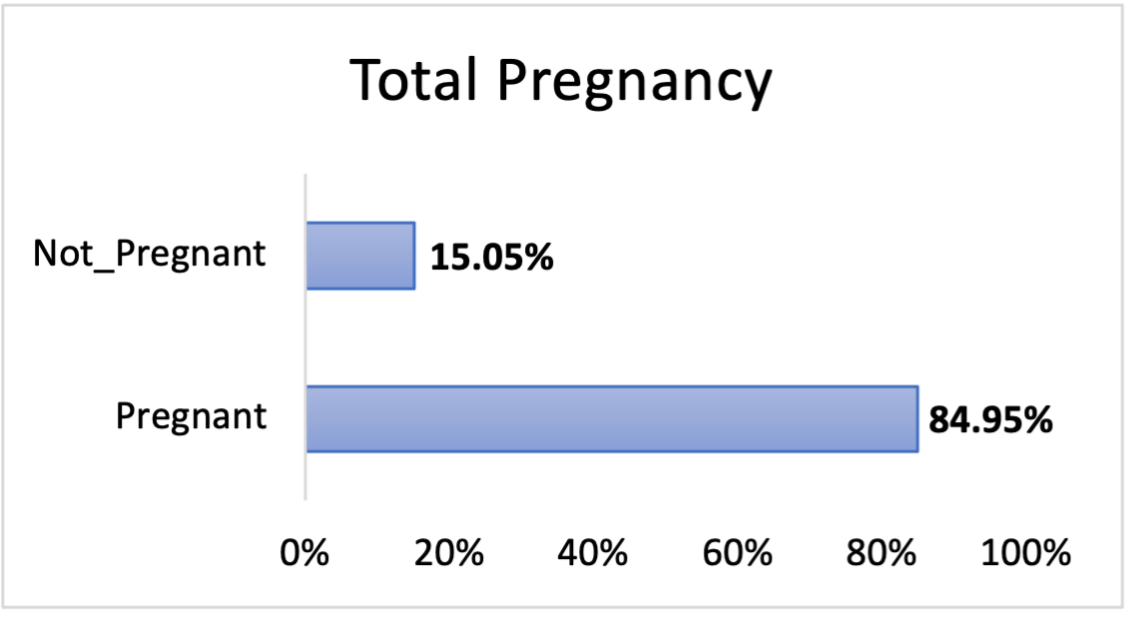
EXCEL

Slide 20
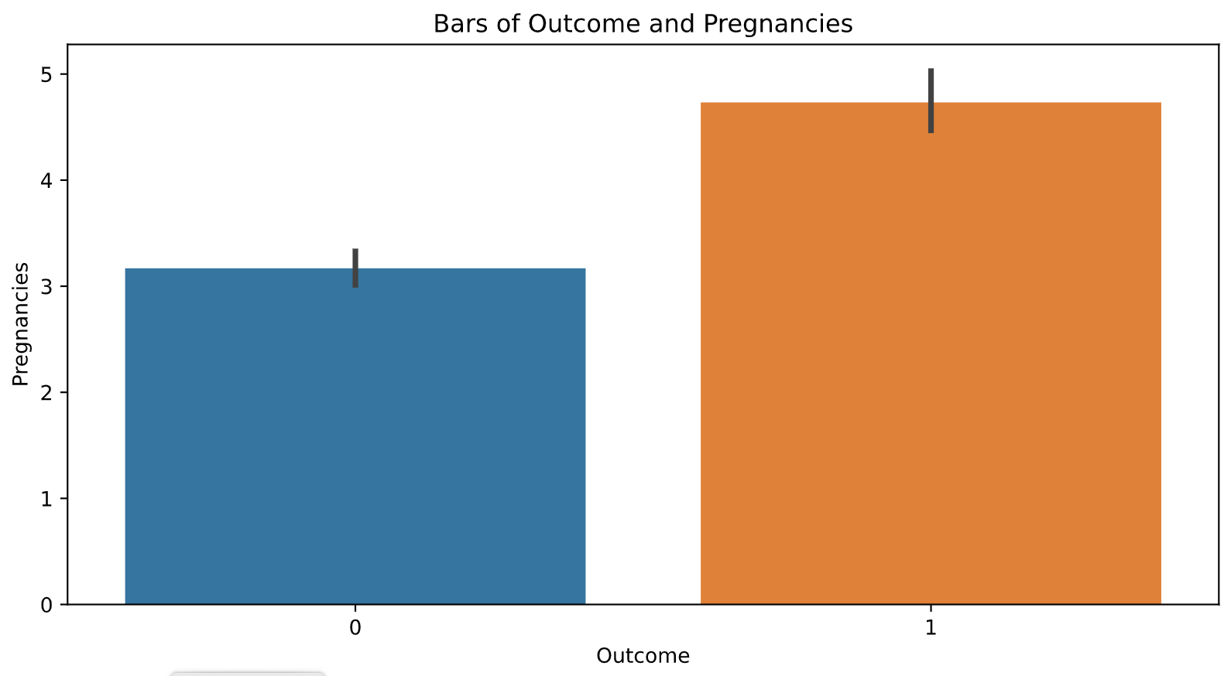
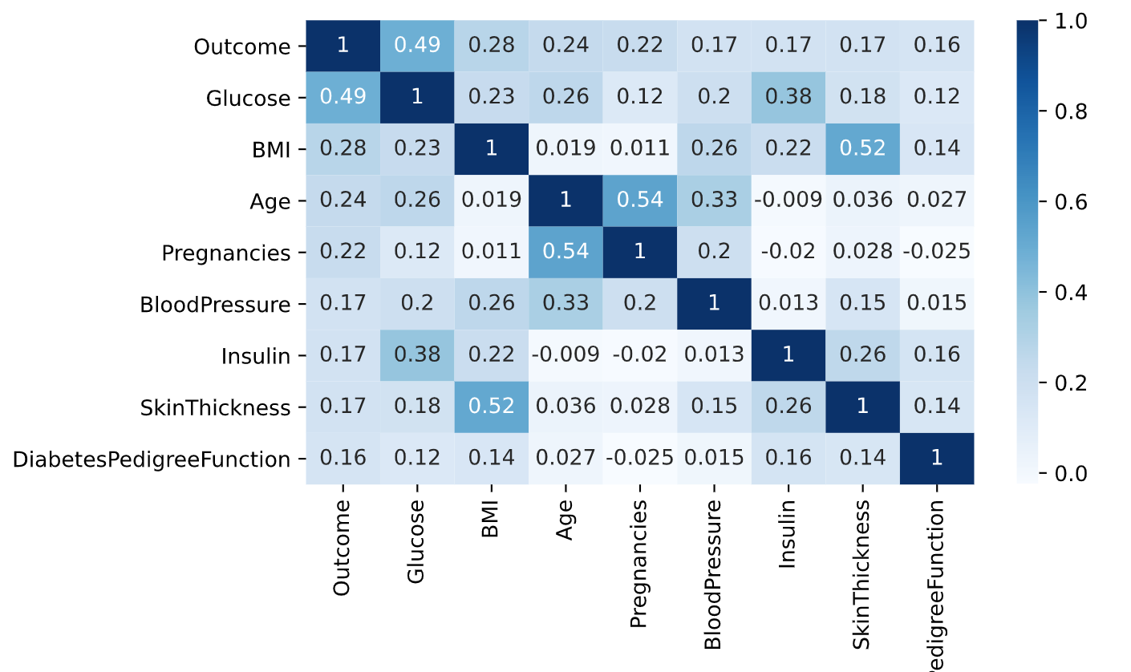
PYTHON

Slide 21
SOURCES
https://gis.cdc.gov/grasp/diabetes/DiabetesAtlas.html#
https://www.kaggle.com/vikasukani/diabetes-data-set
https://slidesgo.com/

